Slide 1


Next Hikes User Analytics in the Telecommunication Industry – Overview
Manila Dugar

Slide 2
User Engagement Analysis
User engagement analysis is crucial for understanding user behavior and optimizing the product/platform
Sessions frequency, duration of the session, and session total traffic are key engagement metrics
Regularly track and analyze these metrics to drive improvements and increase user engagement

Slide 3
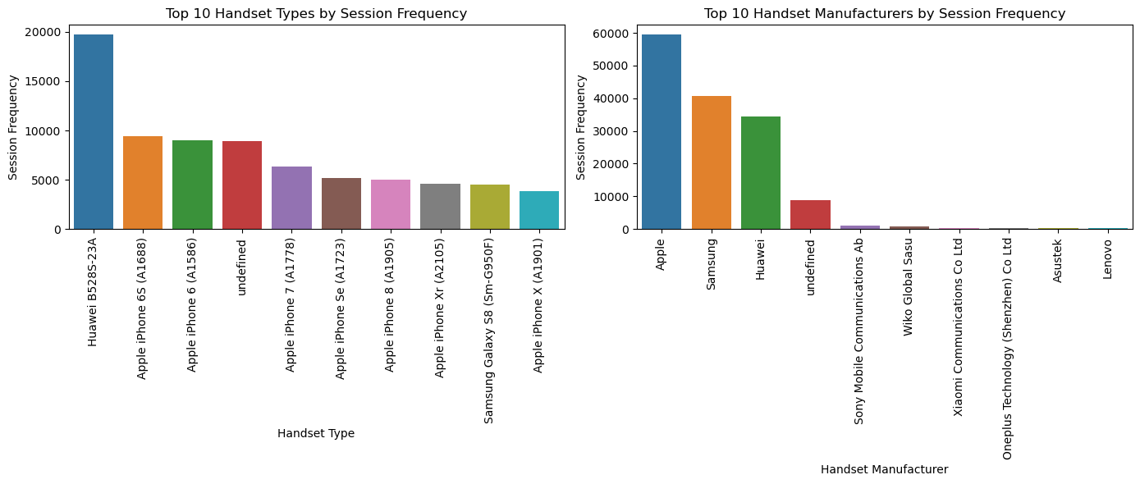
Session Frequency
In the context of network data or telecommunications, session frequency typically refers to the number of sessions or connections established by a specific user or device
Handset Types and Manufacturers Analysis:
Huawei, Apple, and Samsung are the leading handset manufacturers based on session frequency, indicating their popularity and market dominance.
Apple iPhones, particularly models like iPhone 6S, iPhone 6, and iPhone 7, have a significant presence among users, highlighting the need for tailored services and promotions for Apple device users.
Telco should consider optimizing network performance for popular handset types to enhance user experience and satisfaction.
Understanding the "Undefined" category is crucial for identifying users with unclassified devices and addressing their specific needs and preferences.
By combining handset types and manufacturers based on session frequency, telco companies can gain insights into the popularity and usage patterns of different devices in their user base. This information can guide product development strategies, network optimization efforts, and targeted marketing campaigns to better cater to the preferences and requirements of specific handset types and manufacturers, ultimately enhancing customer satisfaction and driving business growth.
Handset Type Session Frequency
Handset Manufacturer Session Frequency

Slide 4
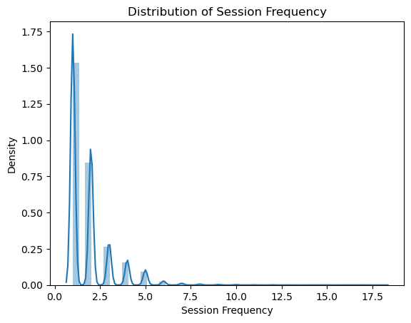
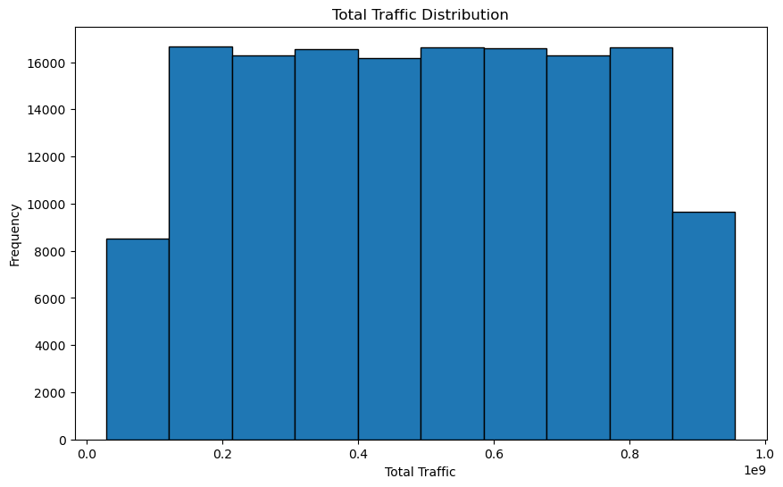
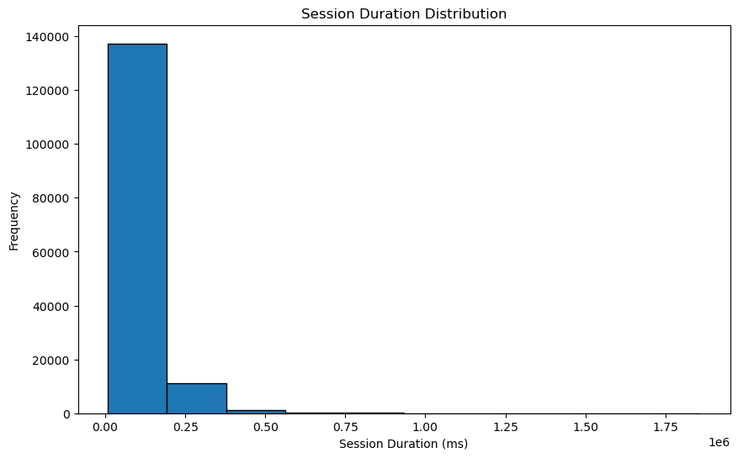
Engagement Metrics
Users may have consistent and regular usage patterns, resulting in a relatively stable session count and duration.
The company's services or offerings may not have experienced significant changes or events that would lead to variations in session behavior.
Users may have specific usage habits or preferences that contribute to the consistent session patterns observed in the data.
Session Frequency
Total Traffic
Session Duration

Slide 5
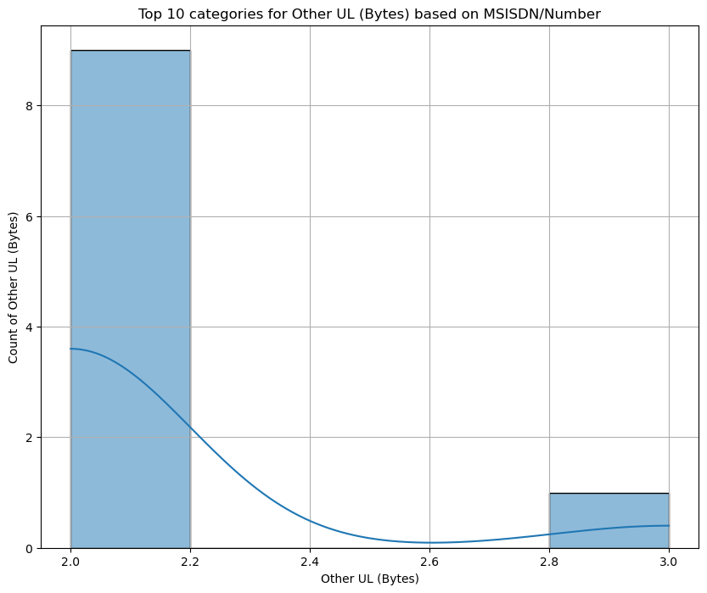
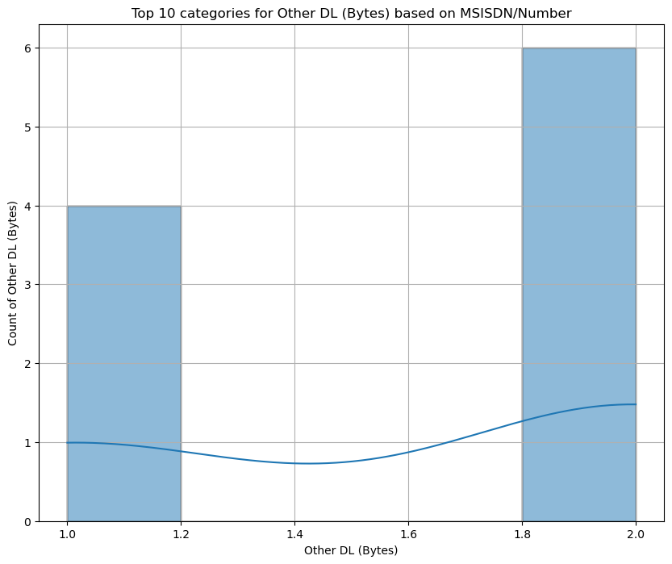

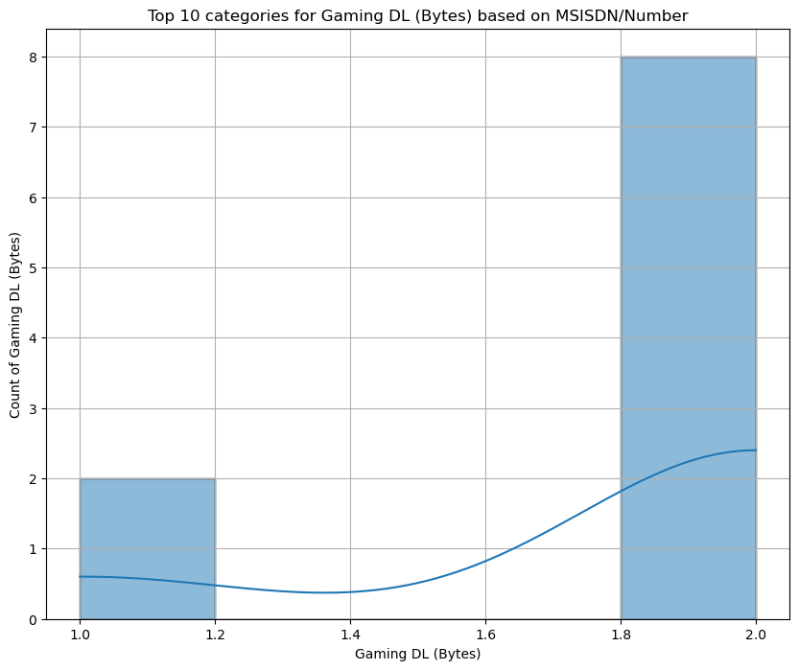
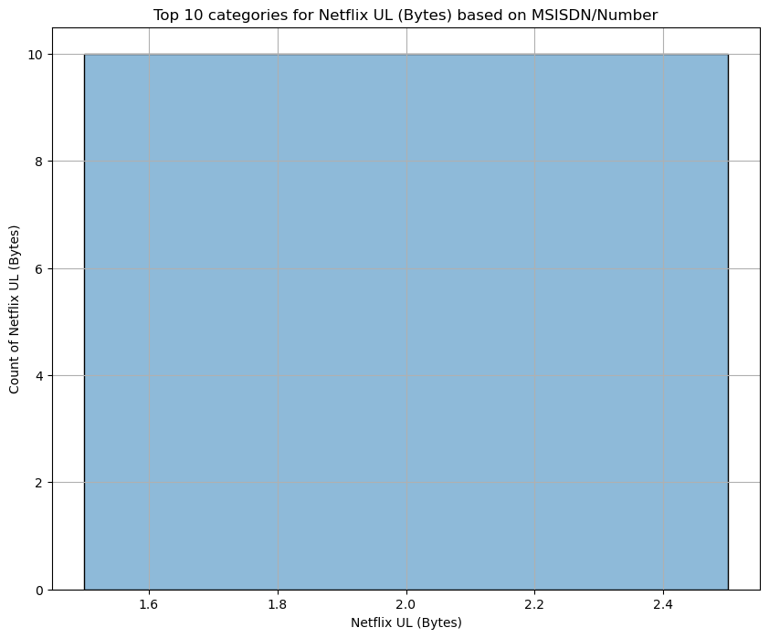

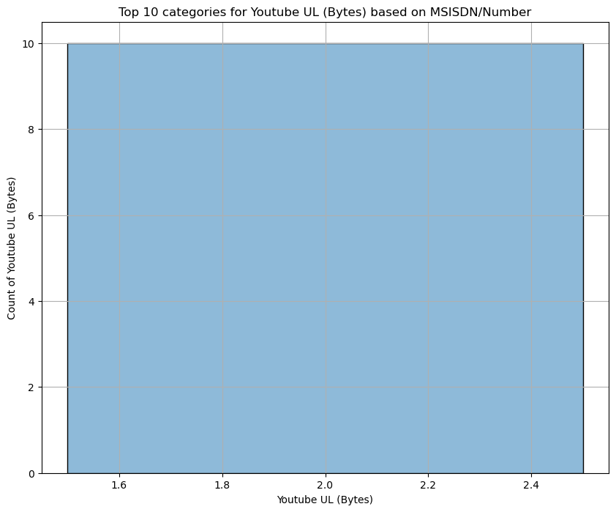



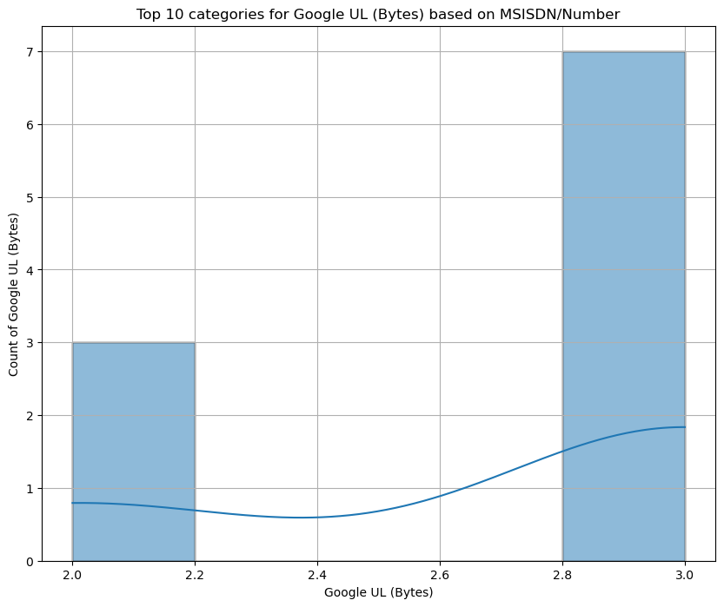
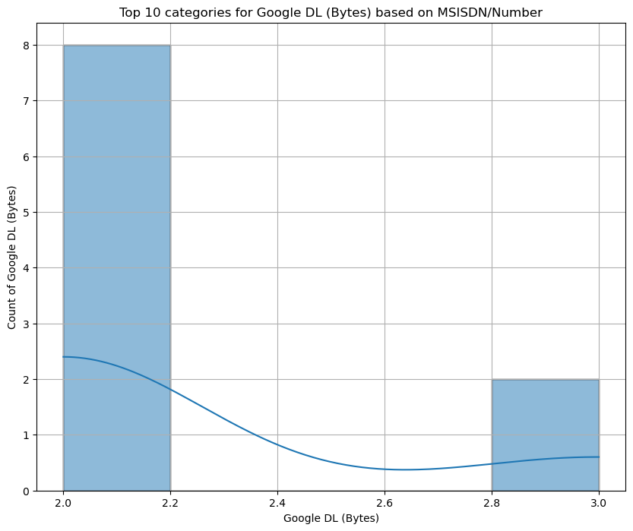
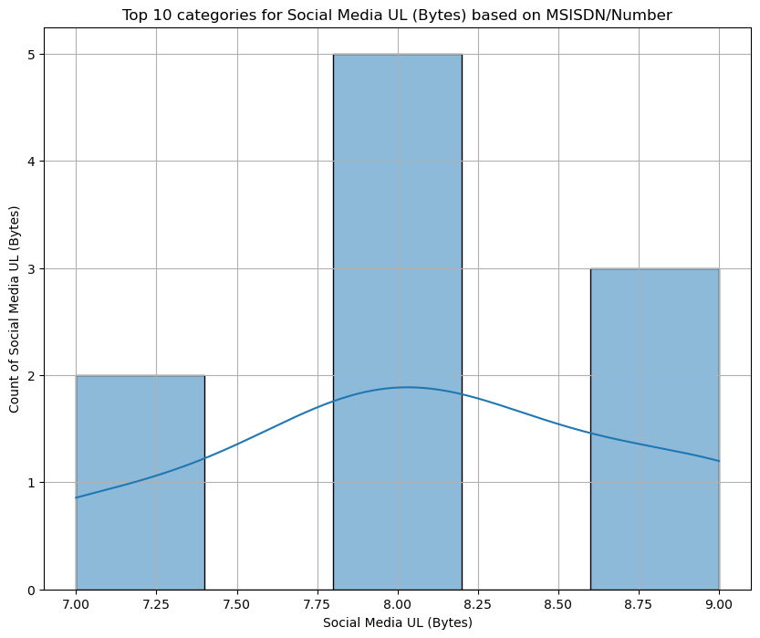
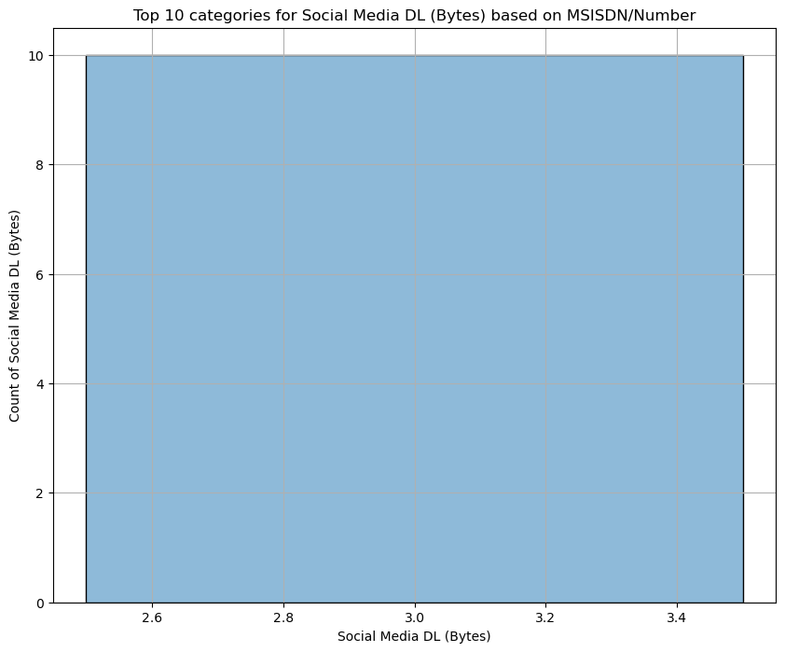
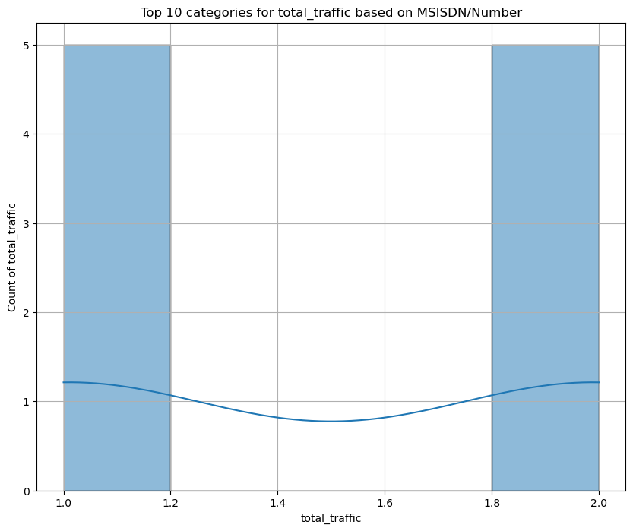
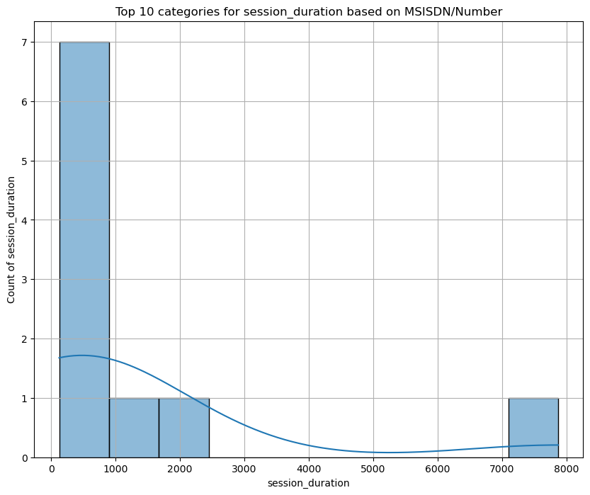
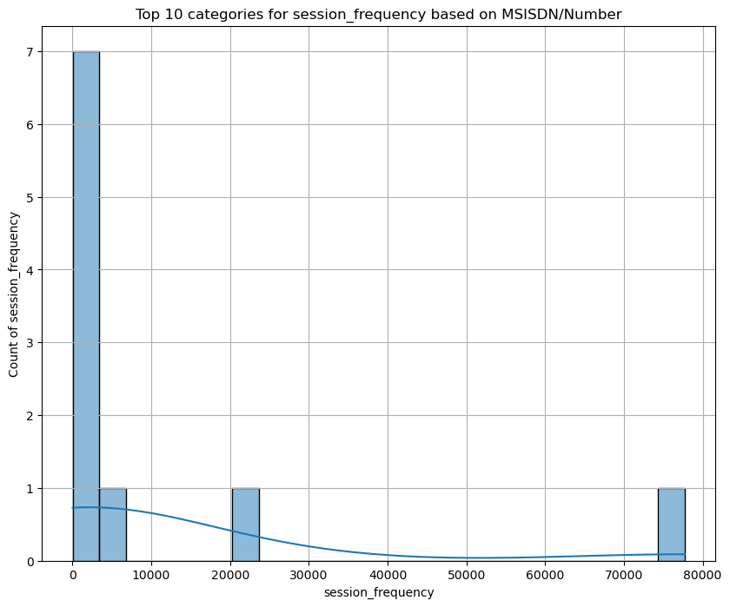
Top 10 customers per engagement metric¶
Other UL
Other DL
Gaming UL
Gaming DL
Netflix UL
Netflix DL
Youtube UL
Youtube DL
Email UL
Email DL
Google UL
Google DL
Socila Media UL
Social Media DL
Total Traffic
Session Duration
Session Frequency

Slide 6
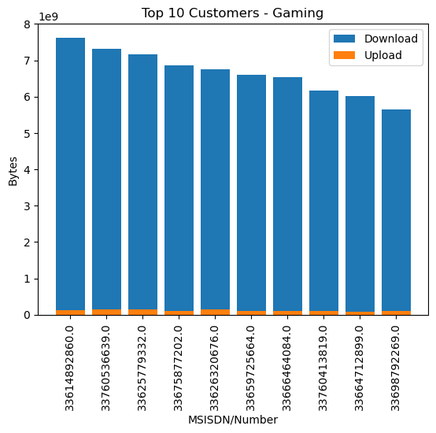
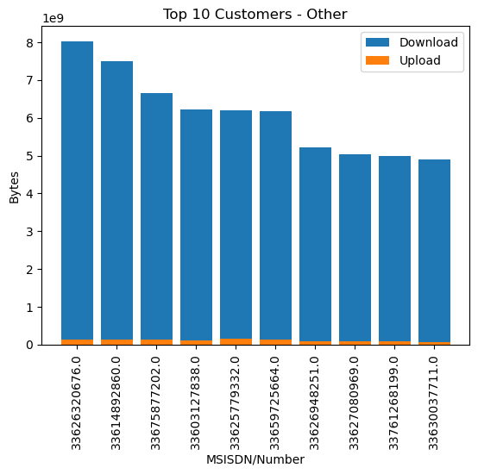
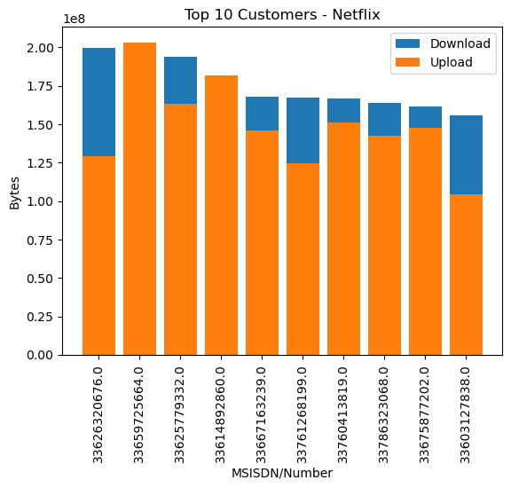
Top_3 Applications
This bar plot focuses on the top 10 customers with the highest data usage, both in terms of download and upload.
The x-axis represents the customers' MSISDN/Number, and the y-axis represents the data usage in bytes.
The plot helps identify the customers who consume the most data.
Analyzing this plot can provide insights into customer usage patterns, identify power users, and potentially reveal application-related trends.

Slide 7
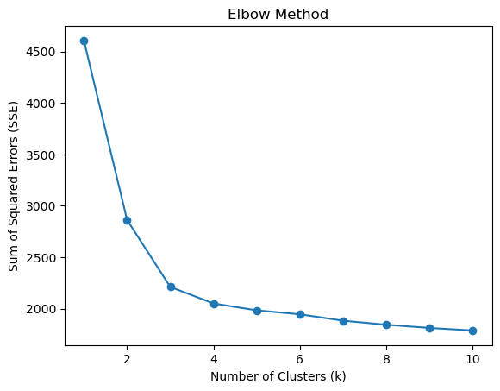
K-means Clustering Algorithm
The elbow method to determine the optimal number of clusters (k) for a given dataset using the K-means clustering algorithm.
The elbow method helps in identifying the value of k that provides the best trade-off between cluster compactness and simplicity.
The range of k values considered is from 1 to 10
The algorithm calculates the sum of squared errors (SSE) for each clustering solution.
k=3 would involve analyzing the plot and determining the position of the elbow point when k is equal to 3.
The elbow point is typically characterized by a significant change in the slope of the SSE curve.
It indicates that adding more clusters beyond that point does not lead to significant improvement in SSE reduction

Slide 8
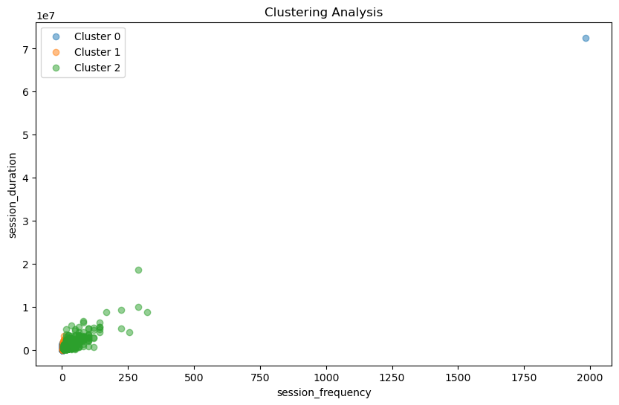
Clustering Analysis of Customer Engagement Metrics
Cluster analysis is a powerful statistical technique used to group similar objects or individuals into meaningful clusters. In the context of our analysis, we applied cluster analysis to a dataset to identify distinct groups of users based on their behavior and usage patterns.
The analysis resulted in the identification of three clusters: Cluster 0, Cluster 1, and Cluster 2. Each cluster represents a unique segment of users with distinct characteristics and behaviors

Slide 9
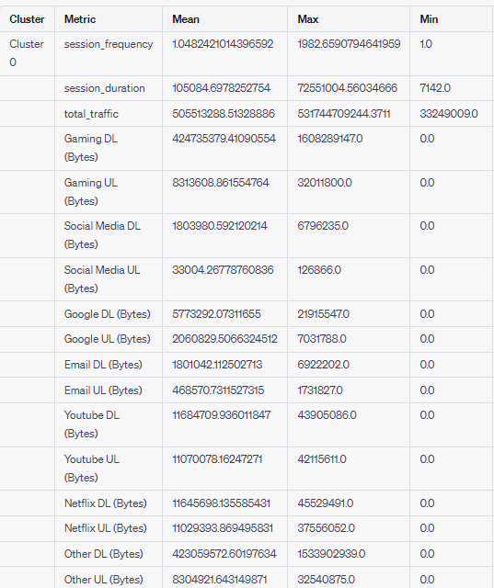
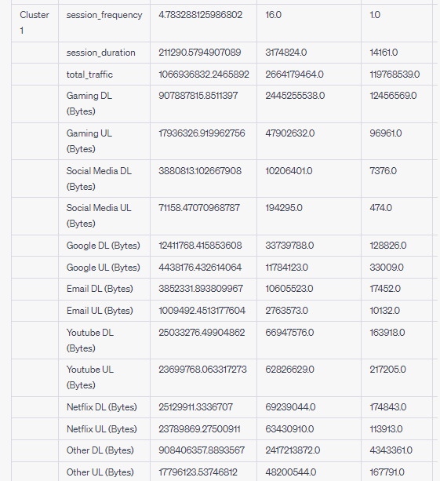
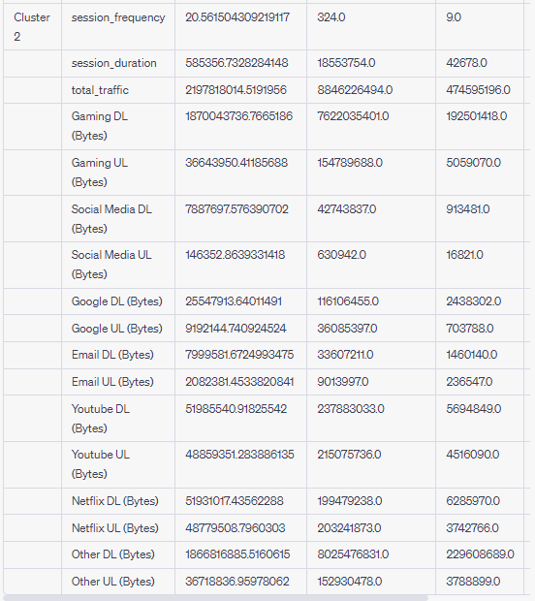
Cluster Statistics For Each Metric

Slide 10
Thank You

